Slide 1


Electricity Bill & Energy Consumption Analyzer
By Sudipta Samanta and Anirban Dey
MS Excel Data Analytics Project
ANP-D5749
Mentored by Mr Sayan Sau

Slide 2
Problem Statement
Electricity consumption is increasing rapidly due to the extensive use of electrical appliances in homes, industries, and commercial sectors. Managing electricity usage efficiently has become important to reduce energy wastage and control electricity bills. However, analyzing large electricity billing datasets manually is difficult and time-consuming.
This project aims to analyze electricity consumption and billing patterns using MS Excel. The project involves data cleaning, KPI analysis, PivotTables, charts, dashboards, and slicers to identify high electricity consumption areas, appliance usage trends, tariff variations, and companies with maximum and minimum electricity bills. The analysis helps in understanding energy consumption behavior and provides insights for better electricity management and energy-saving solutions.

Slide 3
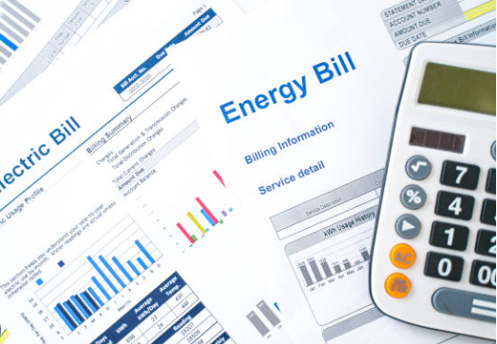
Project Overview
Developed an electricity consumption analysis dashboard using MS Excel.
Analyzed electricity billing and appliance usage patterns.
Created interactive visualizations using pivot tables and charts.

Slide 4
Project Objectives
Analyze electricity consumption data
Compare electricity bills across companies and cities
Visualize energy usage trends
Build an interactive dashboard in Excel
Generate business insights from data

Slide 5
Dataset Details
Dataset Fields:
City
Company
TariffRate
ElectricityBill
MonthlyHour
Fan
AirCondition
Refrigerator
Television
Monitor
MotorPump
Cleaned and processed using MS Excel

Slide 6
Data Cleaning & Preparation
Removed duplicates
Filled missing values
Standardized text formatting
Converted text data into numeric format
Corrected inconsistent entries

Slide 7
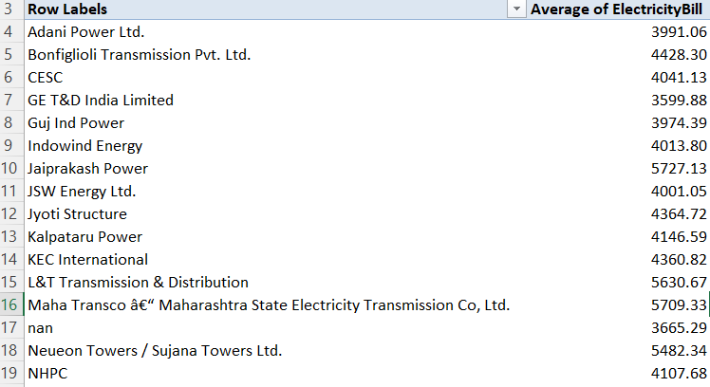
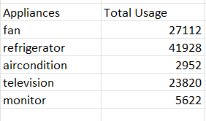
Data Analysis Using Pivot Tables
Created pivot tables for:
Company-wise electricity bill analysis
City-wise consumption analysis
Monthly trend analysis
Appliance usage comparison

Slide 8
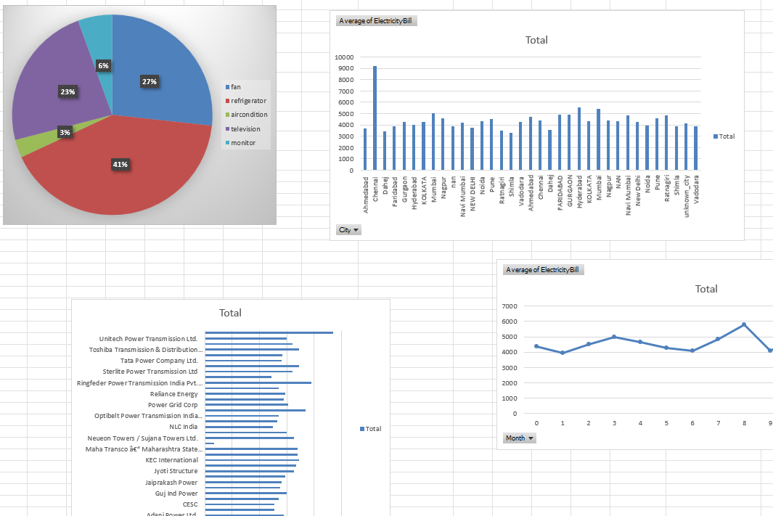
Interactive Dashboard
Dashboard Components:
Bar Chart
Pie Chart
Line Graph
KPI Cards

Slide 9
Key Findings
Refrigerator contribute highest electricity consumption.
Higher tariff rates result in increased electricity bills.
Some cities show significantly higher energy usage patterns.
Dashboard enables quick monitoring and comparison

Slide 10
Tools & Skills Applied
Tools:
MS Excel
Pivot Tables
Charts
Dashboard Design
Skills:
Data Cleaning
Data Visualization
Data Analysis
Dashboard Development

Slide 11
Leading and Lagging Indicators
Leading Indicators:
Appliance Usage
Monthly Usage Hours
Tariff Rate
City Consumption Trend
Lagging Indicators
Total Electricity Bill
Average Bill
Highest Bill
Lowest Bill
Company with Maximum Bill

Slide 12
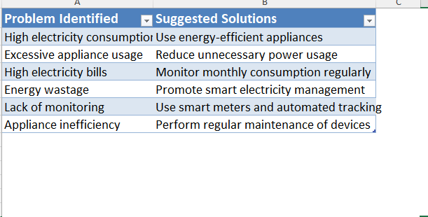
Solutions

Slide 13
Conclusion
Successfully developed an electricity consumption analysis dashboard in MS Excel.
The project improved understanding of data cleaning, pivot analysis, and dashboard creation.
Interactive visualizations helped identify important electricity consumption trends

Slide 14
Thank You

